Slide 1
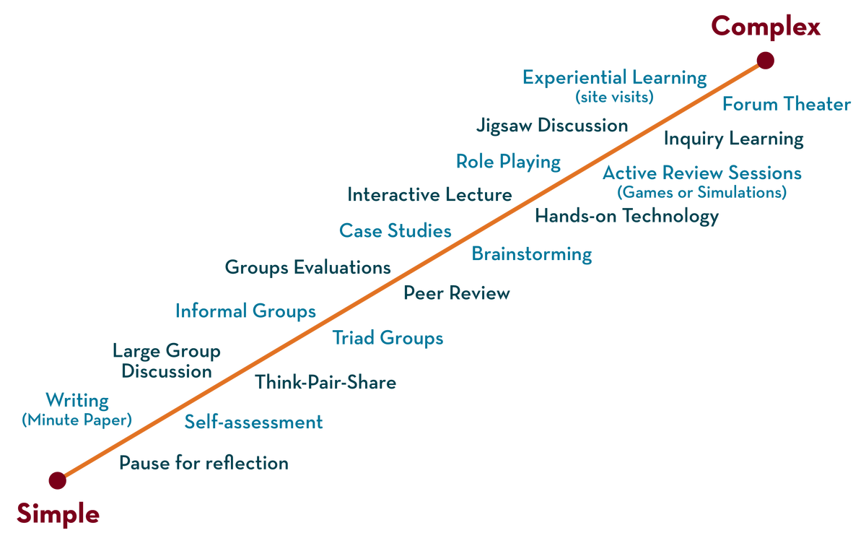
Department of ECE
ANALOG ELECTRONIC CIRCUIT DESIGN 22EC2104
CO-2
Session-1 JFET Structure and operation

Slide 2





AIM OF THE SESSION
To familiarize students with the structure and operation of the Junction Field effect Transistor
INSTRUCTIONAL OBJECTIVES
This Session is designed to:
Give introduction of Junction field effect transistors and it’s structure,
Operation of JFET.
LEARNING OUTCOMES
At the end of this session, you should be able to:
Describe structure of JFET
Describe the operation of JFET
Analyze the operation of JFET

Slide 3
INTRODUCTION
The field-effect transistor (FET) is a three-terminal device used for a variety of applications.
JFET transistor is a voltage-controlled device.
The FET is a unipolar device depending solely on either electron (n-channel) or hole (p-channel) conduction.
One of the most important characteristics of the FET is its high input impedance.
FETs are usually smaller in construction than BJTs, making them particularly useful in integrated-circuit (IC) chips
Ic
Control current I_{b}
BJT
I_{D}
FET
Control voltage V_{GS}

Slide 4
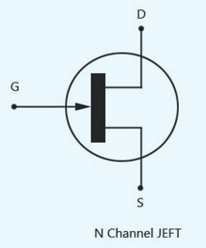
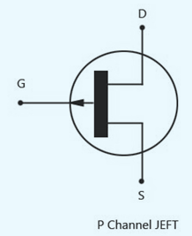
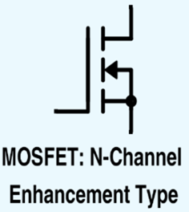
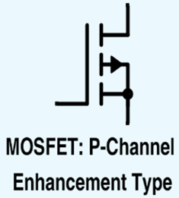
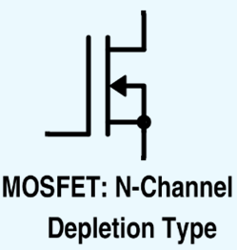
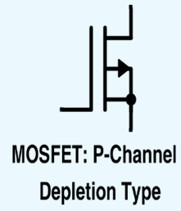
TYPES OF FET’S
Based on the construction, the FET can be classified into two types
Junction field-effect transistor (JFET) and
Metal-oxide-semiconductor field-effect transistor (MOSFET) or IGFET or MOST
Depletion and
Enhancement

Slide 5
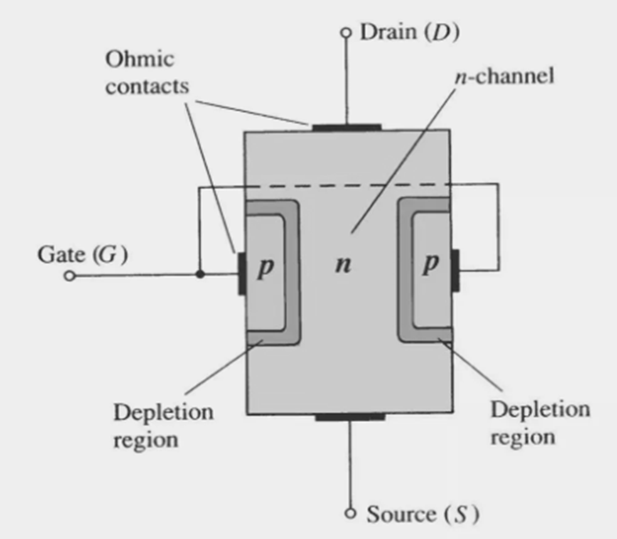
CONSTRUCTION OF JFET
The major part of the structure is the n-type material that forms the channel between the embedded layers of p-type material.
The top of the n-type channel is connected through an ohmic contact to a terminal referred to as the drain (D).
The lower end of the same material is connected through an ohmic contact to a terminal referred to as the source (S).
The two p-type materials are connected together and to the gate (G) terminal.

Slide 6
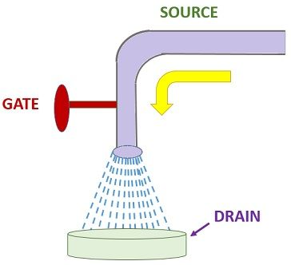
WATER ANALOGY FOR THE JFET CONTROL MECHANISM
Water analogy provide a sense for the JFET control at the gate terminal.
The source of water pressure can be likened to the applied voltage from drain to source that will establish a flow of water (electrons) from the spigot (source)
The “gate,” through an applied signal (potential), controls the flow of water (charge) to the “drain.”
The drain and source terminals are at opposite ends of the n-channel

Slide 7
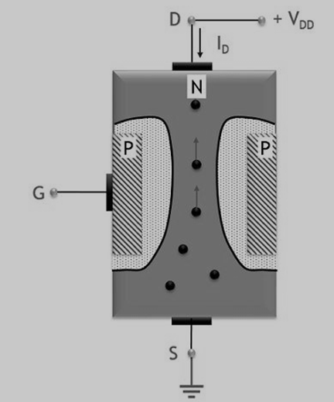
OPERATION OF JFET
V_{GS} =0v, V_{DS} =0
When no external potential is provided to neither gate nor drain corresponding to the source terminal. This means V_{GS} = V_{DS} = 0
In this case, the two p-n junctions will have depletion regions of the same thickness. As no any external biasing is provided, this means due to temperature variation the majority charge carriers (electrons) move from source to the drain terminal.

Slide 8
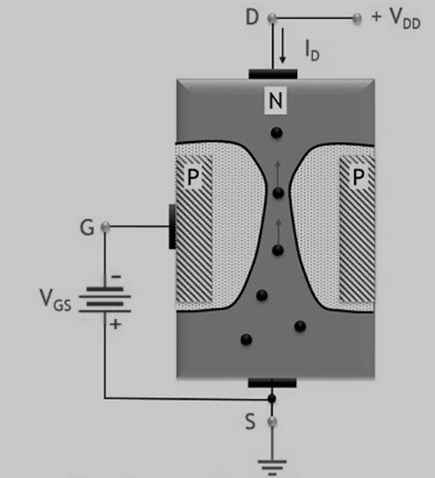
OPERATION OF JFET
(b) V_{GS} ≠0v, V_{DS} =0
When a small voltage is provided between the gate-source terminal. This means V_{GS} ≠ 0
In this condition, when the small reverse potential is provided between gate to source terminal then the reverse voltage enhances (increases) the depletion width of the pn junctions

Slide 9
OPERATION OF JFET
(b) V_{GS} ≠0v, V_{DS} =0
When a small voltage is provided between the gate-source terminal. This means V_{GS} ≠ 0
In this condition, when the small reverse potential is provided between gate to source terminal then the reverse voltage enhances (increases) the depletion width of the pn junctions

Slide 10
OPERATION OF JFET
(c) V_{GS} ≠0v, V_{DS} ≠0v
When high gate to source reverse potential is applied. So, in this case, due to the high reverse gate-source voltage, the depletion width increases further. At the higher gate to source voltage, a point is reached where the two depletion layers meet each other.

Slide 11

SUMMARY
A junction field-effect transistor (JFET) is a three-terminal semiconductor device widely used in electronics. It is constructed using a single semiconductor material, either n-type or p-type.
The JFET consists of a channel region with two ohmic contacts called the source and drain, and a control terminal known as the gate.
Its operation is based on the formation of a depletion region in the channel when a voltage is applied between the gate and the source.
This depletion region controls the flow of current in the channel, resulting in a voltage-controlled current device.
By varying the gate voltage, the JFET regulates the output current, making it suitable for various applications such as amplifiers and switches.

Slide 12
SELF-ASSESSMENT QUESTIONS
1.The JFET is a type of:
a) Bipolar junction transistor
b) Field-effect transistor
c) Vacuum tube
d) Power diode
2.The majority carriers in an n-channel JFET are:
a) Electrons
b) Holes
c) Protons
d) Neutrons

Slide 13
TERMINAL QUESTIONS
How BJT is different from FET?
What id pinch off region of operation?
What is gate terminal in FET?

Slide 14
REFERENCES FOR FURTHER LEARNING OF THE SESSION
Reference Books:
1. Jacob Millman - “Electronic Devices and Circuits”, 4th Edition, McGraw Hill Education (2015)
2. D Roy Choudhury and Shail B. Jain – “Linear Integrated Circuits”, 4th Edition, New Age International Pvt.Ltd. (2017)
3. David A. Bell - “Electronic Devices and Circuits”, 5th Edition, Oxford University Press (2008)
Sites and Web links:
https://www.learnelectronicswithme.com/2020/07/what-is-jfet-construction-and-working.html
https://electronicspost.com/explain-the-construction-and-working-of-a-jfet-what-is-the-difference-between-a-jfet-and-a-bjt/
https://electronicsdesk.com/junction-field-effect-transistor.html

Slide 15
THANK YOU
Team – ANALOG ELECTRONIC DEVICES AND CIRCUITS

